Slide 1
Demonstration and working of slider crank mechanism(SCM)
Topic from Theory of Machines Chapter-1

Slide 2
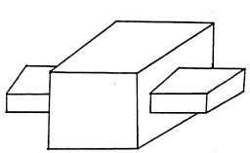
Constraints
Constraints means restrictions. Therefore, when an object is forced to move in a restricted way, its motion is called as constrained motion.
There are three types of constrained motion.
Completely constrained motion: Definite direction of motion irrespective of the direction of applied force.

Slide 3
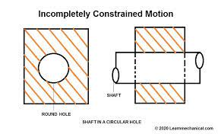
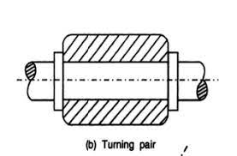
2) Incompletely constrained motion: Motion of the elements/objects are possible in more than one direction and depends upon the direction of force applied.
3) Successfully constrained motion: When incompletely constrained motion is converted into completely constrained motion using some external means, it is called as successfully constrained motion. For example, adding two bearings to restrict the axial motion of the of the circular shaft will allow only restricted rotation of the shaft.

Slide 4
Mechanism and Machine
A number of bodies assembled in such a way that the motion of one causes constrained and predictable motion of other is known as Mechanism.
A Machine is a mechanism or combination of mechanisms which apart from imparting definite motion to the parts, also transmits and modifies the available mechanical energy into some kind of desired work.

Slide 5
Some important terminologies
Rigid and resistant bodies
Link
Kinematic pair
Types of joints
Linkage/Mechanism/Structure
Chain
Classification of kinematic pairs
Degrees of freedom

Slide 6
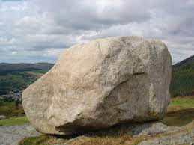
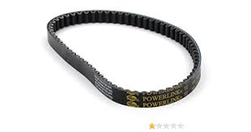
Rigid and Resistant body
Rigid body: A body is said to be rigid if under the action of forces, it does not suffer any distortion or if the distance between any two points on it is not changing.
Resistant body: The bodies which are rigid for the purposes they serve are called as resistant bodies. Some flexible bodies which act as a rigid body under specific loading conditions are also called as resistant bodies. For example Belt.

Slide 7
Links, Kinematic pairs and types of joints
Link: A link is a resistant body or a group of resistant bodies with rigid connection between them preventing any relative motion between them.
Depending upon the number of joints a link has, it can be classified into
Binary link
Ternary link
Quaternary link.
Kinematic pair: A kinematic pair or a pair is the joint between two links having relative motion between them.
If a joint is connecting two links than it is called binary joint; three links than ternary joints and four links then quaternary joint and so on.
Binary link
Ternary link
Quaternary link

Slide 8
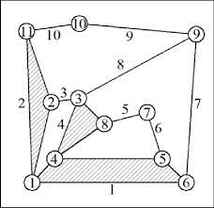
Types of kinematic pairs
According to nature of contact:
Lower pair (surface or area contact)
Higher pair (point or line contact)
According the nature of mechanical constraint
Closed pair (one link is enclosed by the other link and separation is only possible by braking at one of them)
Open pair (The links are in contact by means of gravity or some spring).
Kinematic pair according to the relative motion between them:
Sliding pair
Turning pair
Rolling pair
Screw pair
Spherical pair

Slide 9
Chain
A chain is an assembly of links.
If the relative motion of each link is defined w.r.t other links then it is called as kinematic chain.
If the motion is not defined then it is called as non-kinematic chain.
If there is no motion of the links with respect to the others than it is called a redundant chain.

Slide 10
Linkage, Mechanism and Structure
Linkage or mechanism is obtained if one of the link of the kinematic chain is fixed.
If one of the link of a redundant chain is fixed then it is known as structure.
To obtain a desired motion of the linkage or mechanism, it is important to know how many inputs are required. If the number of input required is 1 than we call the mechanism to have single degree of freedom. If two inputs are required than it is called mechanism with two degree of freedom and so on. A structure will have 0 degree of freedom and if the degree of freedom is negative than it is called a super structure.

Slide 11
Important consideration to create a Mechanism
The output should be pre-defined.
Identifying the number of links to be assembled together.
Identification of type of pair and joints.
Identification of the grounded link.
Identifying the number of inputs.

Slide 12
Four-bar Chain or Four-bar mechanism
Four –bar chain means: There are four links which are connected together to obtain desired predefined motion.
If one link of the chain is fixed then it will be called as four-bar mechanism.
For a four bar linkage or mechanism to work, the thumb rule is that the length of any of its link must not be greater than the sum of other three links.
c
d
b
a

Slide 13
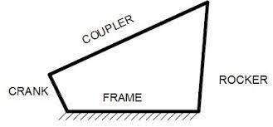
Nomenclature of four-bar mechanism
Based on the type of motion of the link of a four bar mechanism, it is classified into (a) Crank (b) coupler (c) Rocker (d) Frame
The link which completes full revolution is known as crank.
The link adjacent to the crank and opposite to the fixed link is called as lever/coupler/connecting rod.
The link adjacent to the lever or fixed link and opposite to the crank is known as rocker/follower. Some times the rocker also makes full revolution. In such a case the rocker is also called as crank.
The fixed link is called as frame.

Slide 14

Inversion of four-bar mechanism
By fixing different links of a four-bar mechanism,
several types of desired motions can be obtained.
The mechanism created by fixing different links of
The four-bar linkage, are called as inversion.
The main inversions of four-bar mechanisms are:
Crank-rocker mechanism
Double crank mechanism
Double rocker mechanism

Slide 15
Slider-crank mechanism
A slider-crank mechanism is created by replacing a turning pair of four-bar mechanism into a sliding pair.

Slide 16
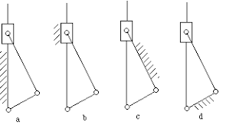
Inversions of Slider-crank Mechanism
The mechanisms obtained by fixing different links of slider-crank mechanism is known as its inversions. Since there are four links, so we will get four inversions.
First inversion can be obtained by fixing the link with one turning and one sliding pair. The example which we discussed in the previous slide is an example.
The application of first inversion is found in IC engines and reciprocating compressors.

Slide 17
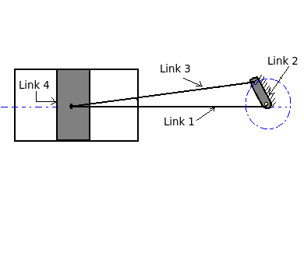
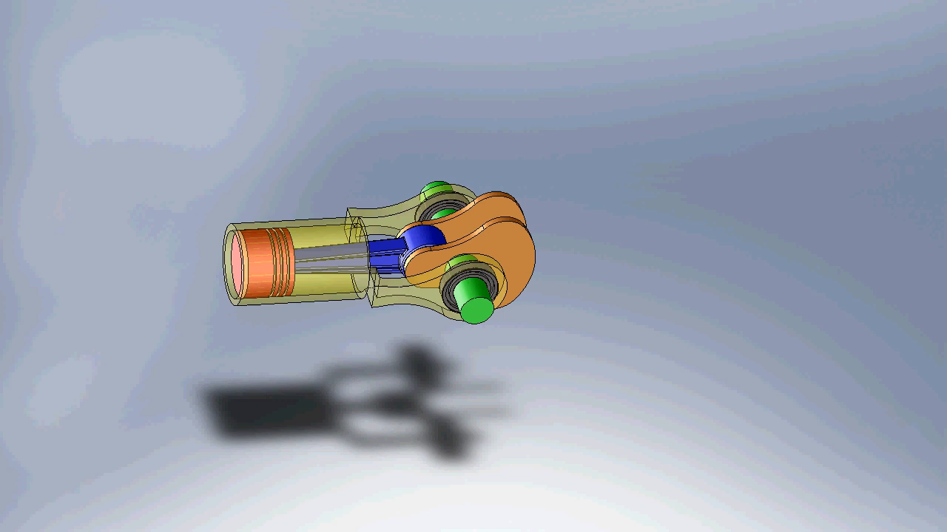
Second inversion (crank fixed)
Similarly the second inversion can be achieved by fixing the crank shaft.
Application in rotary engines and quick-return mechanism.

Slide 18
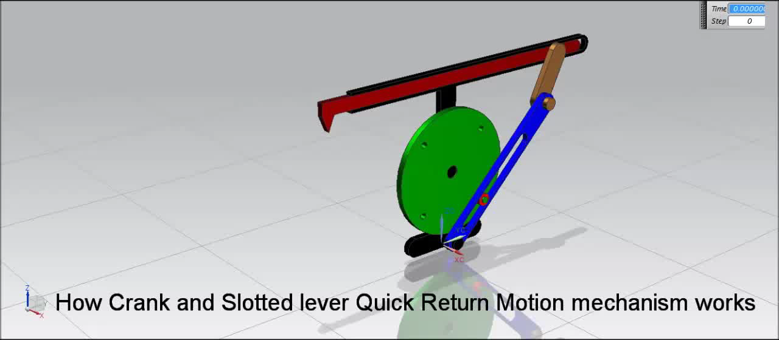
Third inversion (connecting rod fixed)
Applications can be found in oscillating cylinder engine and slotted-lever mechanism.

Slide 19

Fourth inversion (The slider is fixed )
Application in hand pumps

Slide 20
Summary
https://youtu.be/jhPRyg1FHwg
Follow the above link for visualisation of inversions.

